Slide 1







Unit 5.4
Software Engineering
Software
Testing

Slide 2

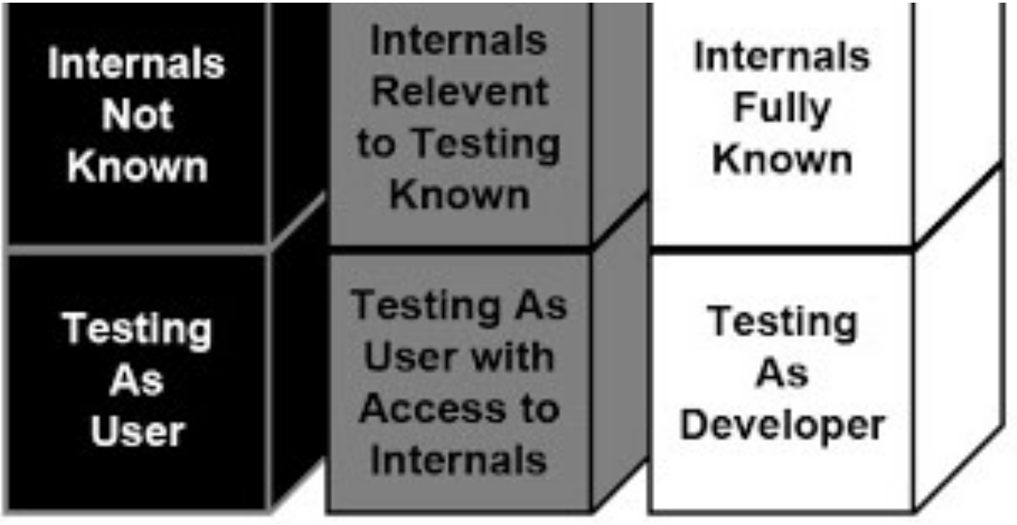
Views of Test Objects
Black Box Testing
White Box Testing
Open Box Testing Testing based on actual source code
Grey Box Testing
Close Box Testing
Testing based only on specification
Partial knowledge of
source code

Slide 3
Black Box Testing
▪
▪
Also known as specification-based testing
Tester has access only to running code and the specification it is supposed to satisfy.
Test cases are written with no knowledge of internal workings of the code
No access to source code
So test cases don’t worry about structure
Emphasis is only on ensuring that the contract is met
▪
▪
▪
▪

Slide 4
Black Box Testing Cont.
▪
Advantages
•
•
•
•
•
•
Scalable; not dependent on size of code
Testing needs no knowledge of implementation Tester and developer can be truly independent of Tests are done with requirements in mind
each
other
Does not excuse inconsistencies in the specifications
Test cases can be developed in parallel with code
▪
Disadvantages
•
•
•
•
Test size will have to be small
Specifications must be clear, concise, and correct May leave many program paths untested Weighting of program paths is not possible

Slide 5
Black Box Testing Cont.
Test Case Design
▪
▪
▪
Examine pre-condition, and identify equivalence classes
All possible inputs such that all classes are covered
Apply the specification
to
input
to
write
down
expected output
Specification
Operation op
Pre: X Post: Y
Test Case 1
Input: x1 (sat. X) Exp. Output: y2
Specification- Based Test Case Design
Test Case 2
Input: x2 (sat. X) Exp. Output: y2

Slide 6




Black Box Testing Cont.
▪
Exhausting testing is not always possible when there is a large set
of input combinations, because of budget and time constraint.
The special techniques are needed which select test-cases smartly
▪
from the all combination of test-cases
scenarios are covered.
in such a way that all
Two techniques are
used
Equivalence Partitioning
Boundary
Value Analysis (BVA)

Slide 7
Black Box Testing Cont.
Equivalence Partitioning
▪
Input data
for
a program
unit usually falls into a number of
partitions, e.g. all negative integers, zero, all positive numbers
Each partition of input data makes the program behave in
similar way
Two test cases based on members from the same partition
likely to reveal the same bugs
▪
a
▪
is
By identifying and testing one member of each partition we gain
'good' coverage with 'small' number of test cases
Testing one member of a partition should be as good as testing any
member of the partition

Slide 8
Black Box Testing Cont.
Example - Equivalence Partitioning
▪
Example:
for binary search the following
that conform to pre-conditions
partitions exist
•
•
•
•
Inputs
Inputs Inputs Inputs
where
where where
the
the the
precondition is false
key element is a member of the array
key element is not a member of the array
▪
Pick specific conditions of the array
•
•
•
The array has a single value
Array length is even
Array length is odd

Slide 9
Black Box Testing Cont.
Example - Equivalence Partitioning
▪
Example: Assume that
we have to test field which accepts
SPI
(Semester
Performance
SPI
Index)
as
input (SPI range is 0 to 10)
* Accepts value 0 to 10
Equivalence Partitioning
Invalid
Valid
Invalid
<=-1
0 to 10
>=11
▪
▪
Valid Class: 0 – 10, pick
any one input test data from 0 to 10
or
Invalid Class 1: <=-1, pick any one input test data less than equal to -1
Invalid Class 2: >=11, pick any one input test data greater than equal to 11
▪
or

Slide 10
Black Box Testing Cont.
Boundary Value Analysis (BVA)
▪
▪
It arises from the fact that most program fail at input boundaries
Boundary testing is the process of testing between extreme ends
or boundaries between partitions of the input values.
In Boundary Testing, Equivalence Class Partitioning plays a good role
Boundary Testing comes after the Equivalence Class Partitioning
The basic idea in boundary value testing is to select input variable values at their:
▪
▪
▪
Just below the minimum
Just below the maximum
Minimum
Maximum
Just above the minimum
Just above the maximum

Slide 11
Black Box
Testing Cont.
Boundary Value Analysis (BVA)
Boundary
Boundary
Boundary Values
▪
Suppose
inclusive”
system
asks
for
“a
number
between
100
and
999
▪
▪
The boundaries are 100 and 999
We therefore test for values
99
100
101
999
999
1000
Lower boundary
Upper boundary

Slide 12
White Box Testing
▪
▪
Also known as structural testing
White
Box Testing
is a
software
testing method in
which
the
internal structure/design/implementation of the module being
tested is known to the tester
Focus is on ensuring that even abnormal invocations are handled gracefully
Using white-box testing methods, you can derive test cases that
▪
▪
•
Guarantee that all independent paths within a module have been
exercised at least once
Exercise all logical decisions on their true and false sides
Execute all loops at their boundaries
Exercise internal data structures to ensure their validity
•
•
•

Slide 13
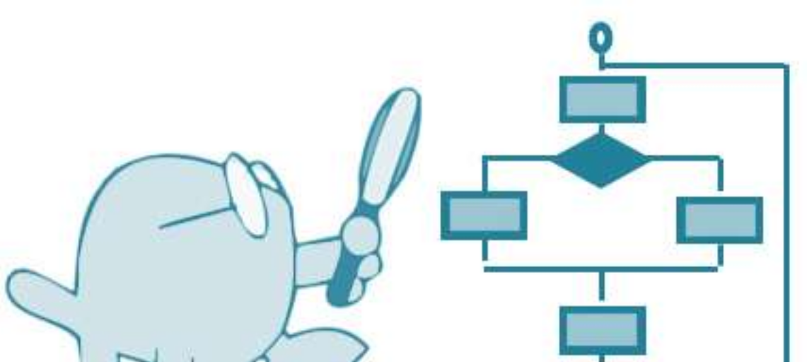

White Box Testing
...our goal is to
ensure that all statements and conditions have been executed at least once ...
It is applicable to the following levels of software testing
•
•
•
Unit Testing: For testing paths within a unit
Integration Testing: For testing paths between units
System Testing: For testing paths between subsystems

Slide 14
White Box Testing Cont.
▪
Advantages
•
Testing can be commenced at an earlier stage as one need not wait for the GUI to be available.
Testing is more thorough, with the possibility of covering most paths
•
▪
Disadvantages
•
Since tests can be very complex, highly skilled resources are required, with thorough knowledge of programming and implementation
Test script maintenance can be a burden, if the implementation changes too frequently
Since this method of testing is closely tied with the application
•
•
being
testing,
tools
to
cater
to
every
kind
of
implementation/platform may not be readily available

Slide 15
White-box
testing strategies
▪
One white-box testing strategy is said to be stronger than another
strategy, if all types of errors detected by the first testing strategy
is also detected by the second testing strategy, and the second testing strategy additionally detects some more types of errors.
White-box testing strategies
▪
•
•
Statement coverage
Branch coverage
•
Path coverage

Slide 16
Statement Coverage
▪
It aims to design test cases so that every statement in a program
is executed at least once
Principal idea is unless a statement is executed, it is very hard to determine if an error exists in that statement
▪
▪
Unless a statement is
executed,
it is
very
difficult
to
observe
whether it causes failure
due
to
some
illegal
memory access,
wrong result computation, etc.

Slide 17
Statement Coverage Cont.
Consider the Euclid’s
GCD
computation
algorithm
int
int
{
1
2
compute_gcd(x, y)
x,
y;
while (x! = y){
if (x>y) then
3
4
5
6
}
x= x –
else y= y – x;
}
return x;
y;
By choosing the test set {(x=3,
y=3), (x=4, y=3), (x=3, y=4)}, we can exercise the
program such that all statements are executed at least once.

Slide 18
Branch coverage
▪
In
the
branch
coverage
based
testing
strategy,
test
cases are
designed to make
false values in turn
It is also known as edge of a program’s
each
branch condition to assume true and
▪
edge
Testing as in this testing scheme, each
control flow graph is traversed at least once
▪
Branch coverage guarantees statement coverage, so it is stronger
strategy compared to Statement Coverage.

Slide 19
Path Coverage
▪
In this strategy test cases are executed in such a way that every
path is executed at least once
All possible control paths taken, including
▪
•
•
All loop paths taken zero, once and multiple items in technique
The
test
case are
prepared
based
on
the logical
complexity
measure of the procedure design
Flow graph, Cyclomatic Complexity and Graph Metrices are used to arrive at basis path.
▪

Slide 20
Grey Box Testing
▪
▪
Combination of white box and black box testing
Tester
has
access
to
source
code,
but
uses
it
in a
restricted
manner
Test cases are still written using specifications based on expected outputs for given input
These test cases are informed by program code structure
▪
▪

Slide 21
Configuration Testing
▪
Configuration variability and instability are important factors that
make WebApp testing a challenge.
▪
Hardware,
operating
system(s),
browsers, storage capacity,
network communication speeds, and a variety of other client-side
factors are difficult to predict for each user.
One user’s impression of the WebApp and the manner in which he/she interacts with it can differ significantly.
▪
▪
Configuration testing is to test a set of probable client-side and
server-side configurations
•
to ensure that the user experience will be the same on all of
them and,
to isolate errors that may be specific to a particular configuration
•

Slide 22
Test documentation
Test Plan
What: a document describing the scope, approach, resources and schedule of intended testing activities; identifies test items, the features to be tested, the testing tasks, who will do each task and any risks requiring contingency planning;
Who: QA;
When: (planning)/design/coding/testing stage(s);

Slide 23
Test documentation
Test Plan (cont’d)
Why:
Divide responsibilities between teams involved; if more than one QA team is involved (ie, manual / automation, or English / Localization) – responsibilities between QA teams ;
Plan for test resources / timelines ;
Plan for test coverage;
Plan for OS / DB / software deployment and configuration models coverage.
- QA role:
Create and maintain the document;
Analyze for completeness;
Have it reviewed and signed by Project Team leads/managers.

Slide 24
Test documentation
Test Case
What: a set of inputs, execution preconditions and expected outcomes developed for a particular objective, such as exercising a particular program path or verifying compliance with a specific requirement;
Who: QA;
When: (planning)/(design)/coding/testing stage(s);
Why:
Plan test effort / resources / timelines;
Plan / review test coverage;
Track test execution progress;
Track defects;
Track software quality criteria / quality metrics;
Unify Pass/Fail criteria across all testers;
Planned/systematic testing vs Ad-Hoc.

Slide 25
Test documentation
Test Case (cont’d)
Five required elements of a Test Case:
ID – unique identifier of a test case;
Features to be tested / steps / input values – what you need to do;
Expected result / output values – what you are supposed to get from application;
Actual result – what you really get from application;
Pass / Fail.

Slide 26
Test documentation
Test Case (cont’d)
Optional elements of a Test Case:
Title – verbal description indicative of testcase objective;
Goal / objective – primary verification point of the test case;
Project / application ID / title – for TC classification / better tracking;
Functional area – for better TC tracking;
Bug numbers for Failed test cases – for better error / failure tracking (ISO 9000);
Positive / Negative class – for test execution planning;
Manual / Automatable / Automated parameter etc – for planning purposes;
Test Environment.

Slide 27
Test documentation
Test Case (cont’d)
Inputs:
Through the UI;
From interfacing systems or devices;
Files;
Databases;
State;
Environment.
Outputs:
To UI;
To interfacing systems or devices;
Files;
Databases;
State;
Response time.

Slide 28
Test documentation
Test Case (cont’d)
Format – follow company standards; if no standards – choose the one that works best for you:
MS Word document;
MS Excel document;
Memo-like paragraphs (MS Word, Notepad, Wordpad).

